Slide 1
Tools for Targeted Sequencing and NGS analysis
O. Harismendy, PhD
BIOM262 – W2016

Slide 2
Multi-Step analysis
Quality Control
Read Alignment
Alignment Refinement
Variant Calling
Variant Annotation
Visualization
Alignment
Variants

Slide 3
Alignment and Variant Calling Pipeline
Process from HiSeq
Align
Refine
Call Variants
HiSeq BCL files
FASTQ format
Mapped BAM
Cleaned BAM
BWA
Align
GATK
Realign
GATK
Call
Left Align Indels
Filter
Evaluate
CASAVA 1.8
Sort
Reformat
-Unmapped
Samtools
Picard
-Duplicates
GATK
Recalibrate
FASTQ format
Mapped BAM
Cleaned BAM
Filtered VCF

Slide 4
File Sizes
 | Depth | FASTQ.gz | BAM | VCF.gz
Genome | 30x | 100-200Gb | 100-200Gb | 2Gb
Exome (50 Mb) | 120x | 5-10 Gb | 10-30Gb | 3-6Mb
Deep Targeted (150 kb) | 1500x | 300-500Mb | 150Mb | 3-6Mb
Assume 100 bp read length

Slide 5
Instrument QC

Slide 6
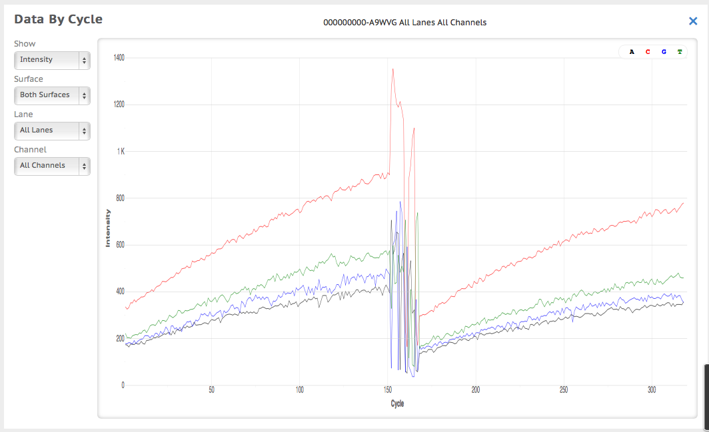
Instrument QC

Slide 7
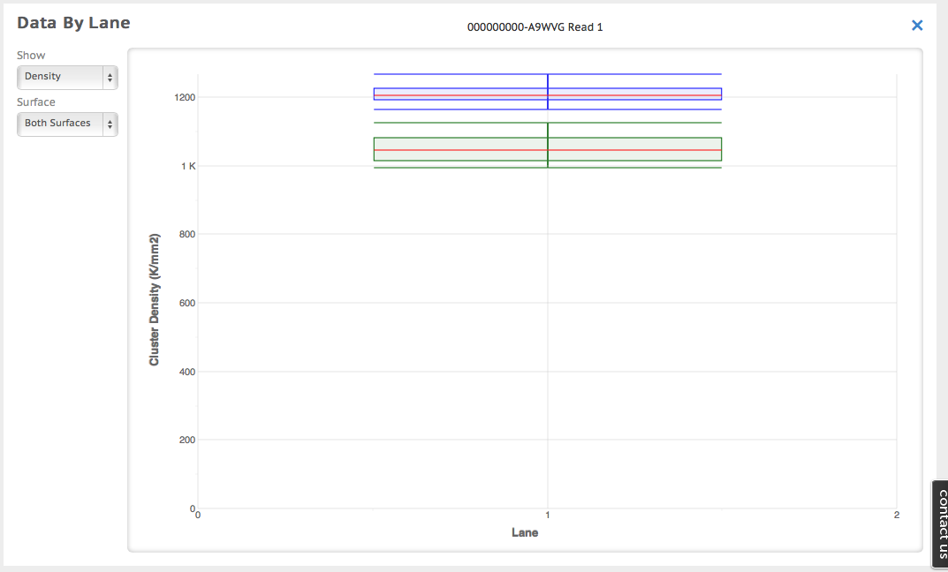
Instrument QC

Slide 8
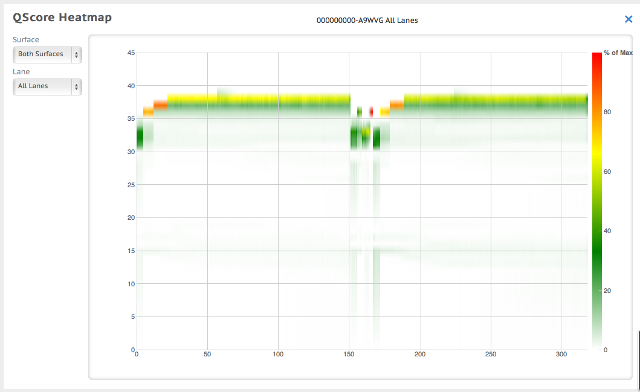
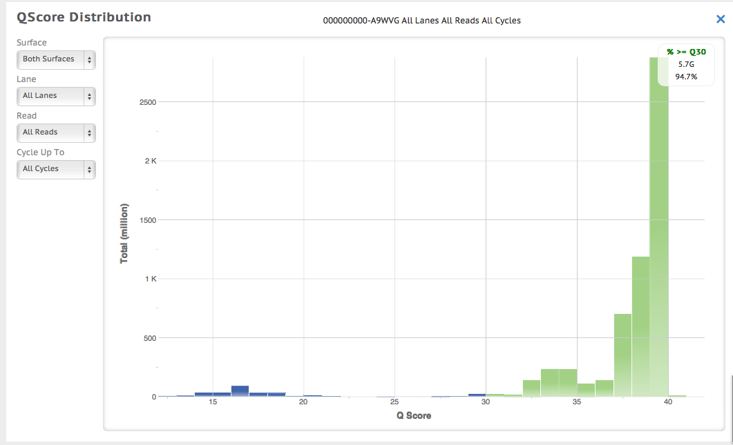
Instrument QC

Slide 9
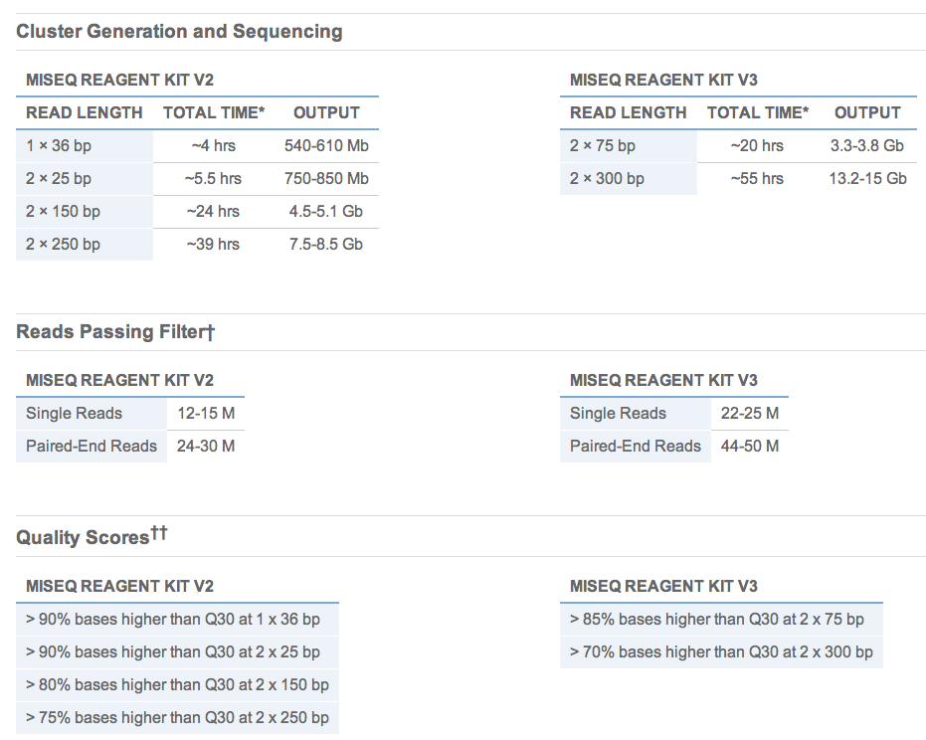
Instrument QC
MiSeq specifications

Slide 10
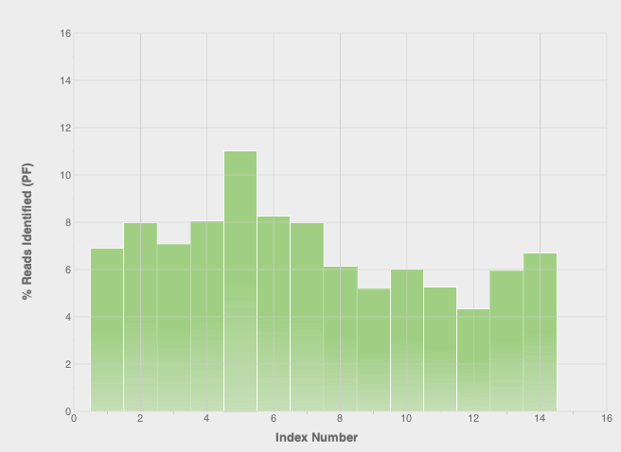
Instrument QC

Slide 11
FASTQ

Slide 12
FASTQ
@IL31_4368:1:1:996:8507/2
TCCCTTACCCCCAAGCTCCATACCCTCCTAATGCCCACACCTCTTACCTTAGGA
+
FFCEFFFEEFFFFFFFEFFEFFFEFCFC<EEFEFFFCEFF<;EEFF=FEE?FCE
@IL31_4368:1:1:996:21421/2
CAAAAACTTTCACTTTACCTGCCGGGTTTCCCAGTTTACATTCCACTGTTTGAC
+
>DBDDB,B9BAA4AAB7BB?7BBB=91;+*@;5<87+*=/*@@?9=73=.7)7*
@IL31_4368:1:1:997:10572/2
GATCTTCTGTGACTGGAAGAAAATGTGTTACATATTACATTTCTGTCCCCATTG
+
E?=EECE<EEEE98EEEEAEEBD??BE@AEAB><EEABCEEDEC<<EBDA=DEE
@IL31_4368:1:1:997:15684/2
CAGCCTCAGATTCAGCATTCTCAAATTCAGCTGCGGCTGAAACAGCAGCAGGAC
+
EEEEDEEE9EAEEDEEEEEEEEEECEEAAEEDEE<CD=D=*BCAC?;CB,<D@,
@IL31_4368:1:1:997:15249/2
AATGTTCTGAAACCTCTGAGAAAGCAAATATTTATTTTAATGAAAAATCCTTAT
+
EDEEC;EEE;EEE?EECE;7AEEEEEE07EECEA;D6D>+EE4E7EEE4;E=EA
@IL31_4368:1:1:997:6273/2
ACATTTACCAAGACCAAAGGAAACTTACCTTGCAAGAATTAGACAGTTCATTTG
+
EEAAFFFEEFEFCFAFFAFCCFFEFEF>EFFFFB?ABA@ECEE=<F@DE@DDF;
@IL31_4368:1:1:997:1657/2
CCCACCTCTCTCAATGTTTTCCATATGGCAGGGACTCAGCACAGGTGGATTAAT
(...)
Instrument serial #
Lane
Swath
X coord
Y coord
Read direction
Notes:
HWUSI-EAS100R the unique instrument name
6 flowcell lane
73 tile number within the flowcell lane
941 'x'-coordinate of the cluster within the tile
1973 'y'-coordinate of the cluster within the tile
#0 index number for a multiplexed sample (0 for no indexing)
/1 the member of a pair, /1 or /2 (paired-end or mate-pair reads only)

Slide 13
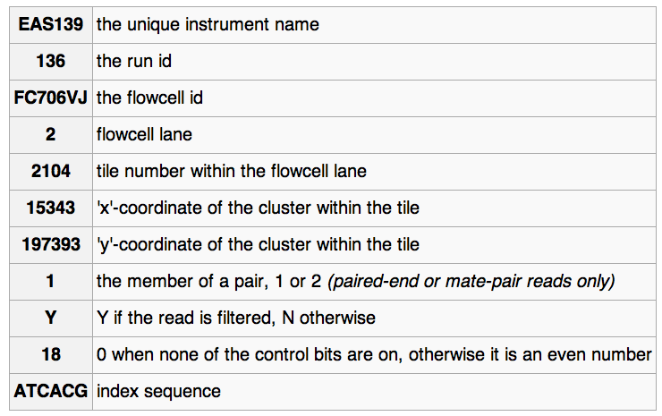
FASTQ read ID variations
@EAS139:136:FC706VJ:2:2104:15343:197393 1:Y:18:ATCACG

Slide 14
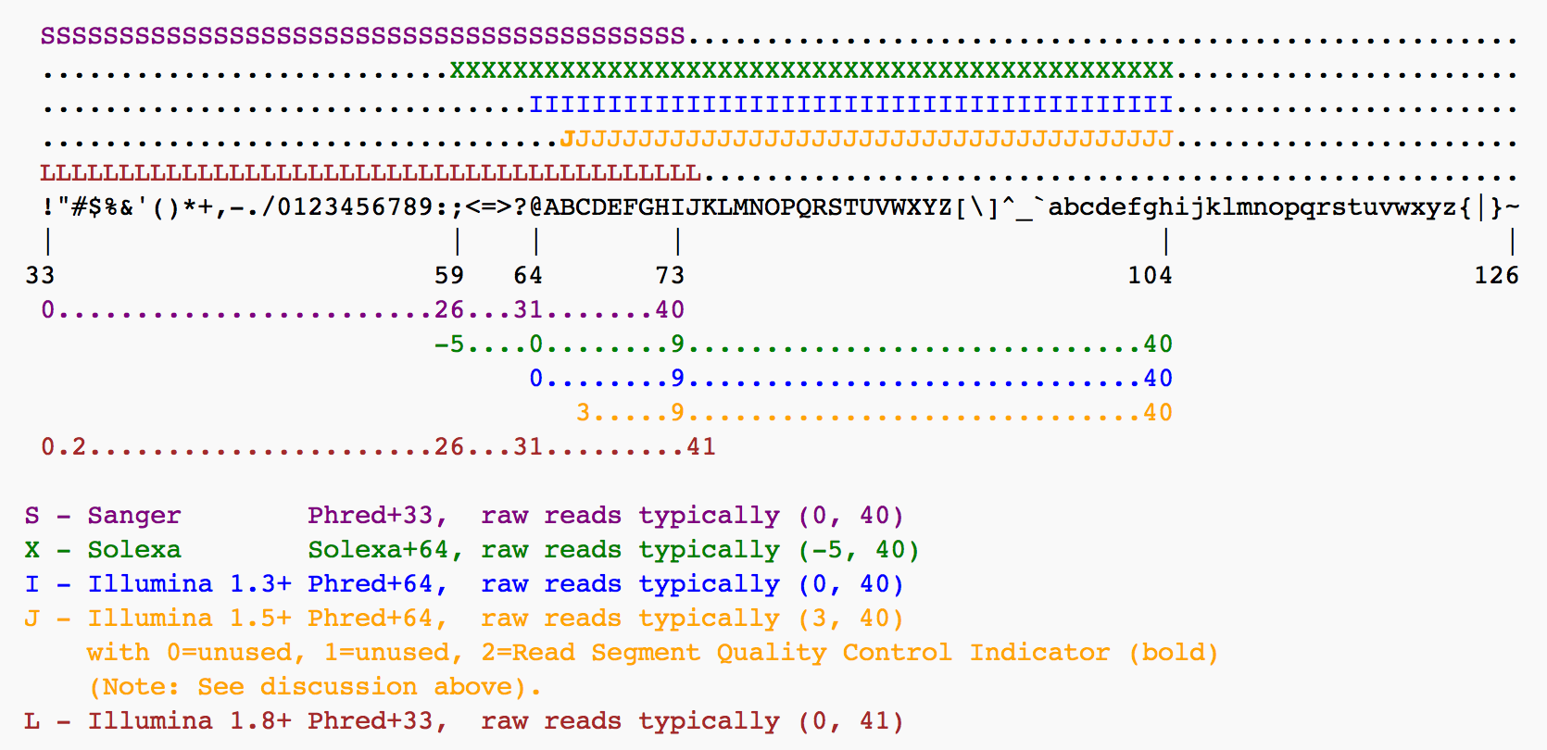
PHRED-like quality
Phred=-10log10(error)

Slide 15
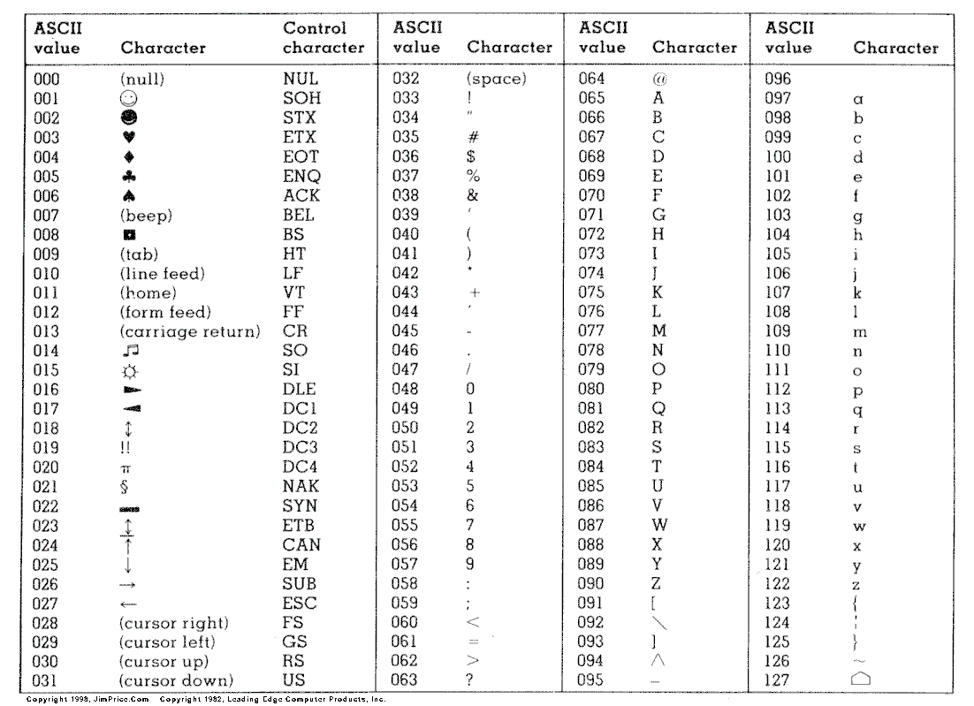
ASCII-Code

Slide 16
FASTQ QC

Slide 17
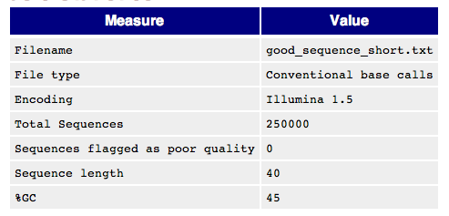
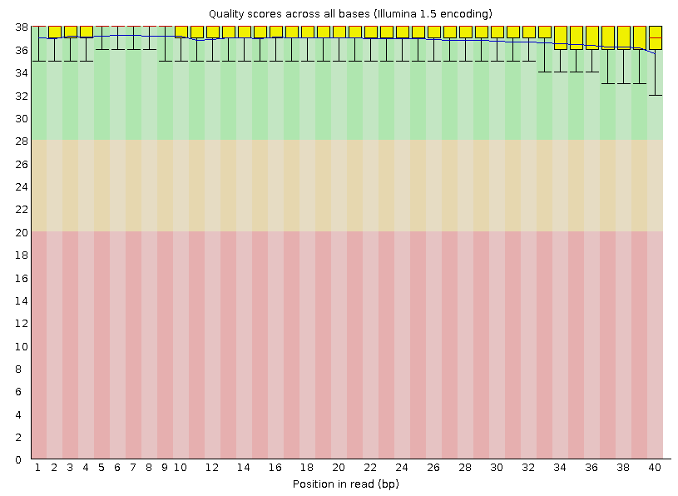
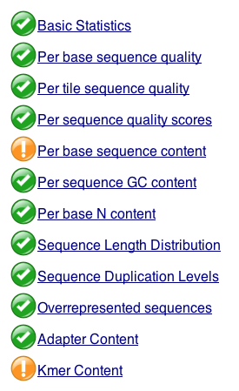
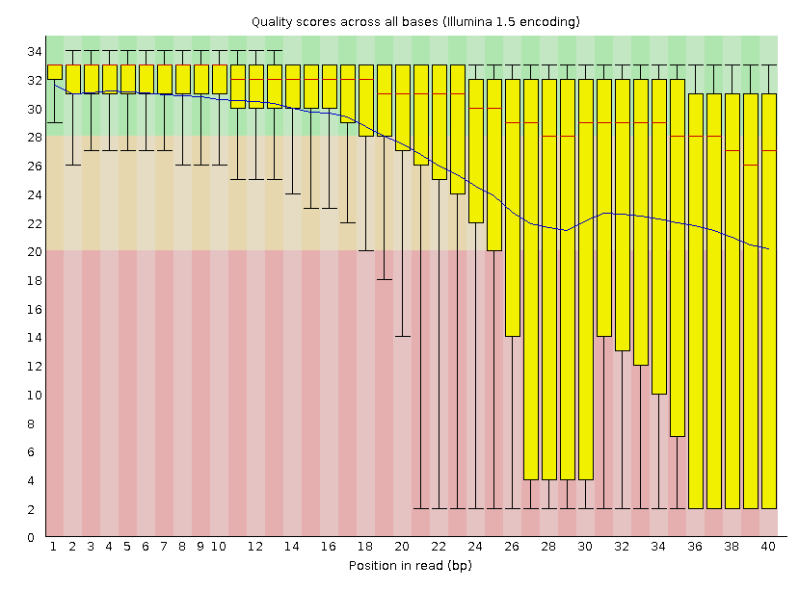
FASTQC
http://www.bioinformatics.babraham.ac.uk/projects/fastqc/

Slide 18
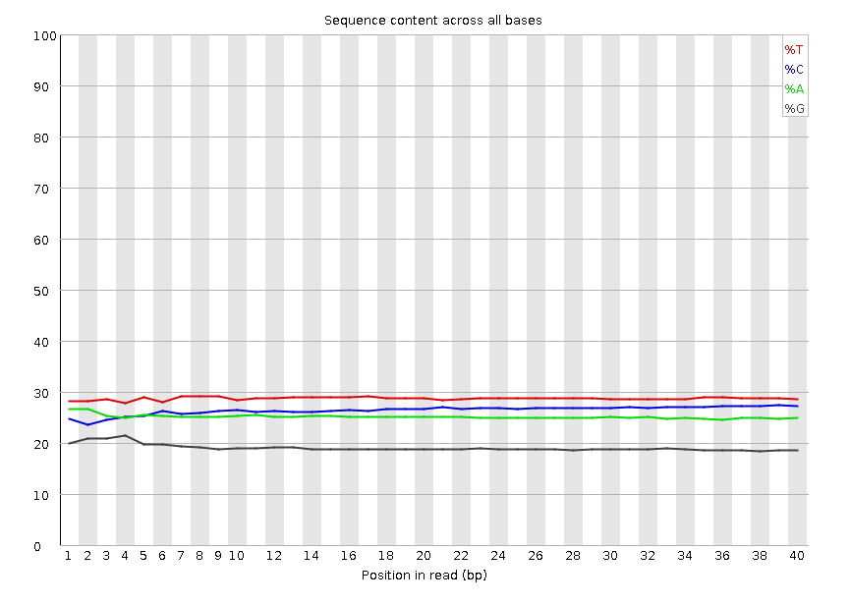
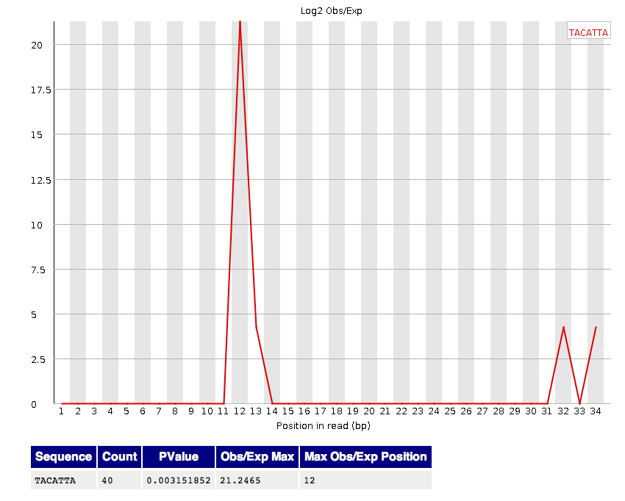
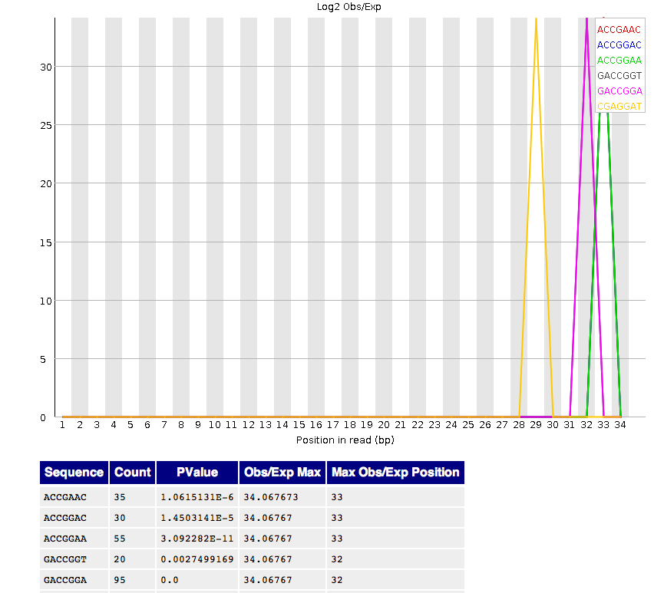
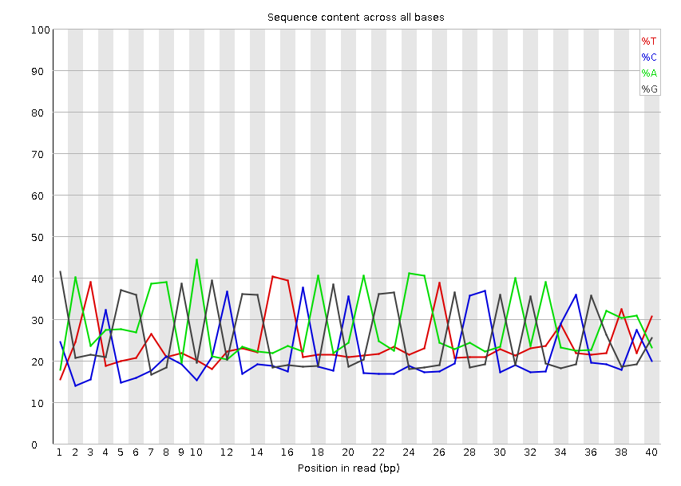
FASTQC Adapter Contamination

Slide 19
Alignment
Using BWA

Slide 20
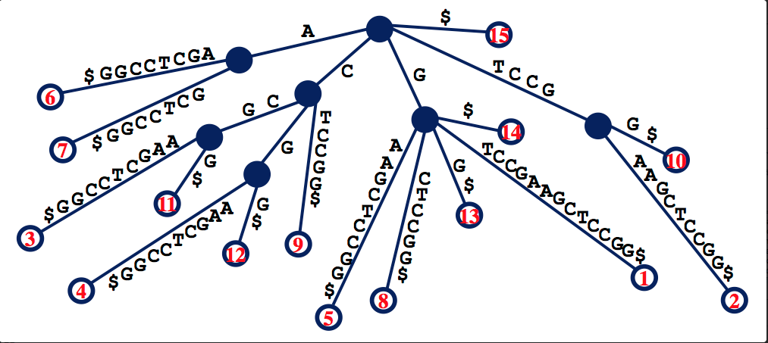
Suffix Array
GTCCGAAGCTCCGG$
Fast but too much memory requirement for the whole genome

Slide 21
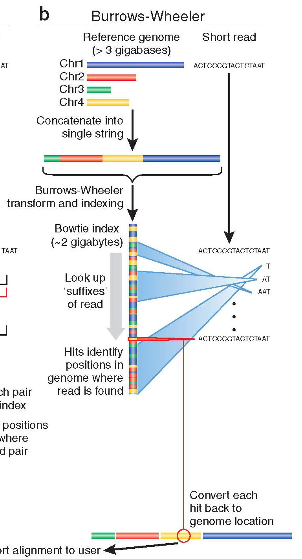
Burrows-Wheeler
Store entire reference genome.
Align tag base by base from the end.
When tag is traversed, all active locations are reported.
If no match is found, then back up and try a substitution.

Slide 22
Burrows-Wheeler Transform (BWT)
BWT
$acaacg
aacg$ac
acaacg$
acg$aca
caacg$a
cg$acaa
g$acaac
acaacg$
gc$aaac

Slide 23
Burrows-Wheeler Matrix
$acaacg
aacg$ac
acaacg$
acg$aca
caacg$a
cg$acaa
g$acaac

Slide 24
Burrows-Wheeler Matrix
3
1
4
2
5
6
$acaacg
aacg$ac
acaacg$
acg$aca
caacg$a
cg$acaa
g$acaac

Slide 25
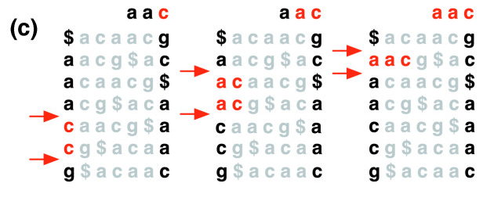
Burrows-Wheeler Transform
Langmead et al (2009)

Slide 26
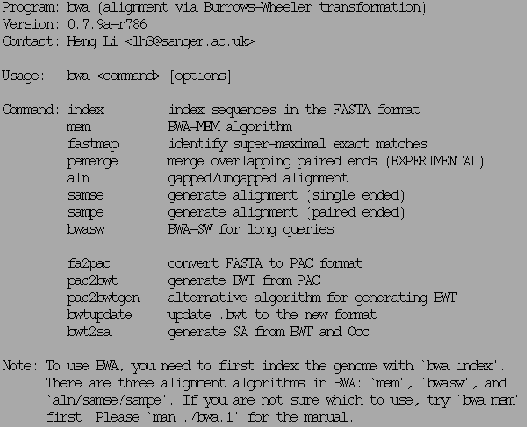
BWA

Slide 27
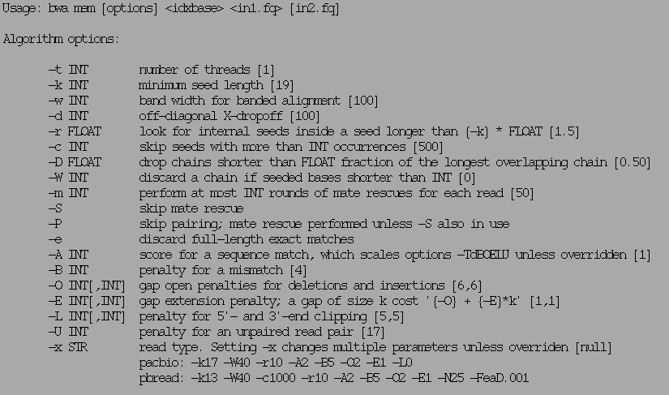
BWA mem

Slide 28
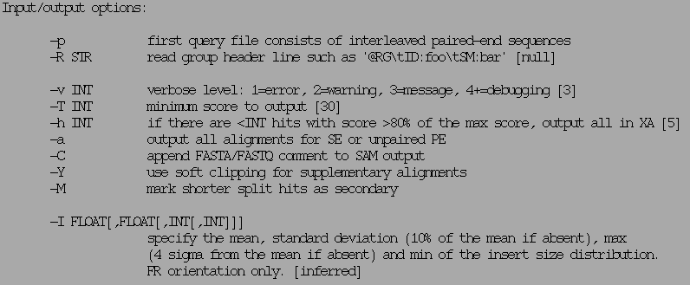
BWA mem

Slide 29
SAM/BAM format

Slide 30
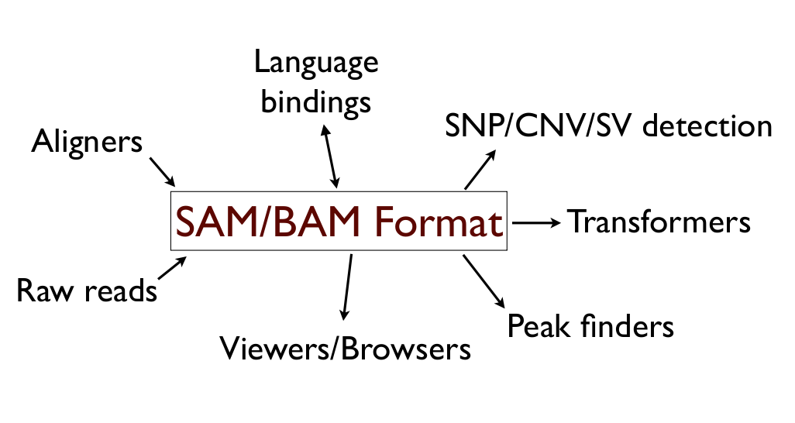
Utility

Slide 31
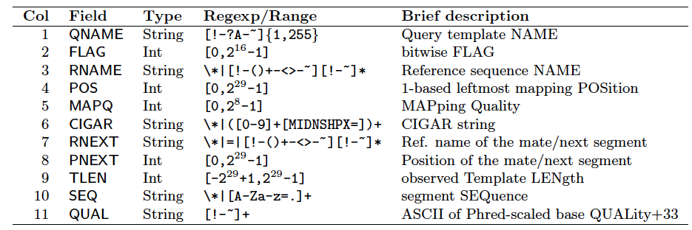
BAM format
Bioinformatics. 2009 Aug 15;25(16):2078-9. Epub 2009 Jun 8. The Sequence Alignment/Map format and SAMtools.

Slide 32
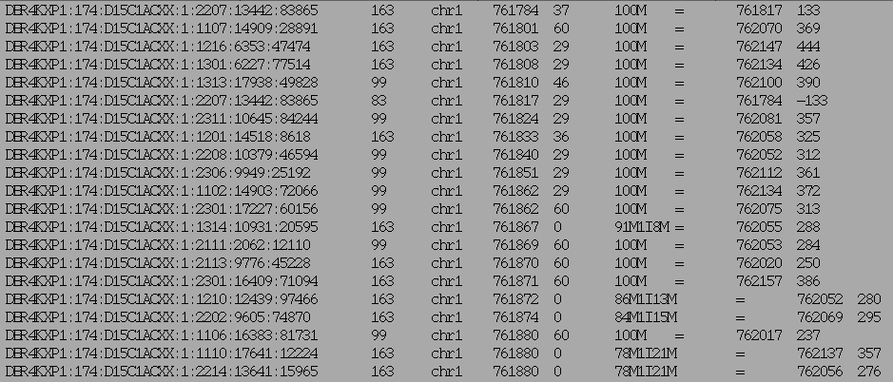
BAM example (field 1-9)

Slide 33
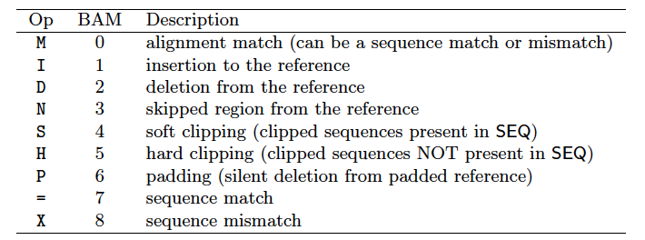
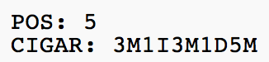
CIGAR string
Before alignment
After alignment

Slide 34
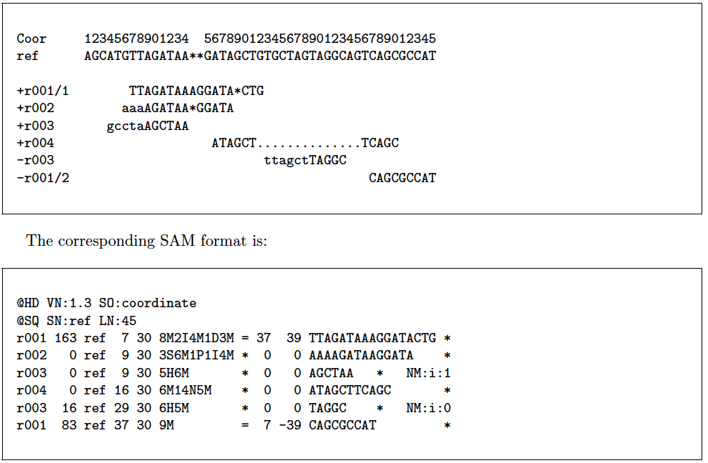
BAM example

Slide 35
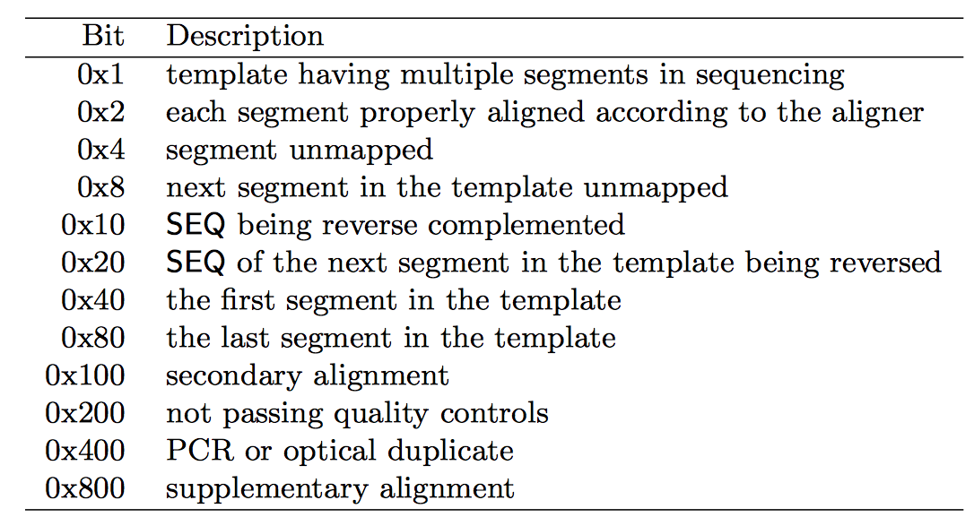
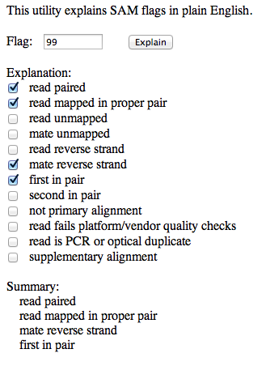
SAM FLAGS
http://picard.sourceforge.net/explain-flags.html

Slide 36
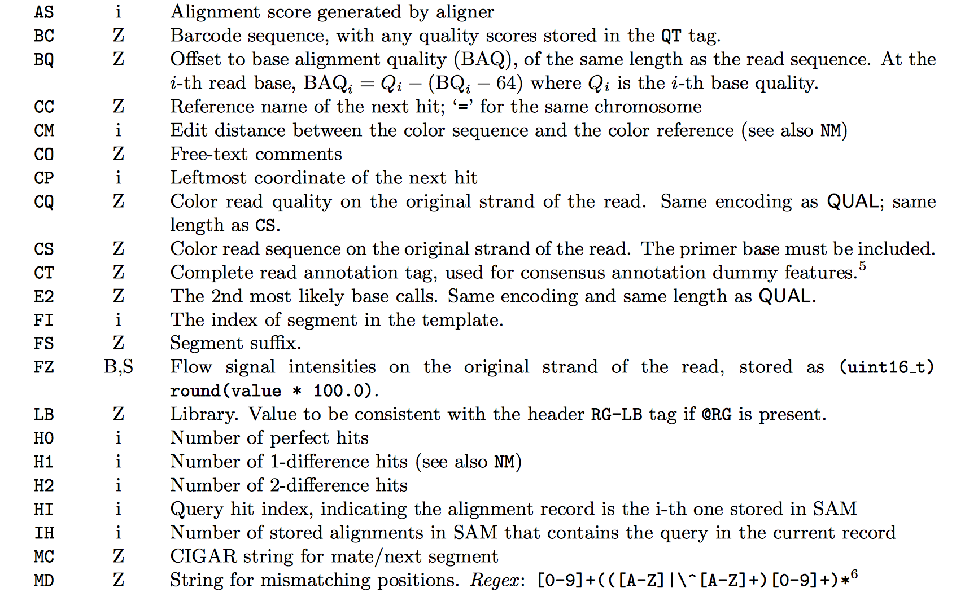
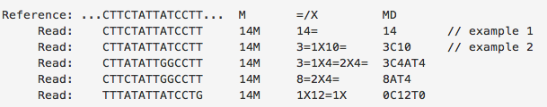
Extra Info (custom)

Slide 37
BAM/SAM format
flexible : compatible with multiple alignment programs
simple: easy to generate and convert
compact in file size
works on a stream : low memory footprint
Indexable for efficiency
SAM is human readable

Slide 38
SAMTOOLS & PICARD
SAM/BAM manipulation

Slide 39
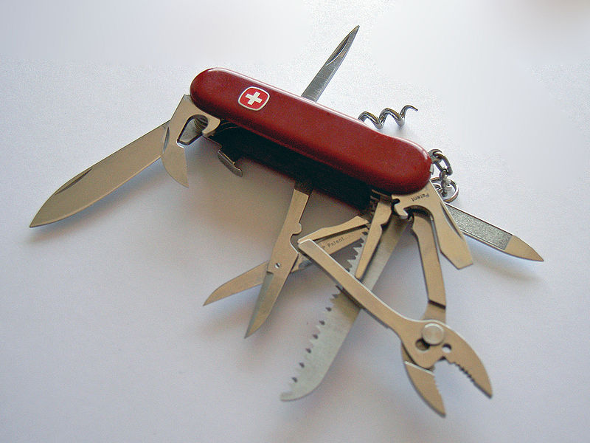

Slide 40
SAMTOOLS
Manipulate alignments in the BAM format
imports from and exports to the SAM (Sequence Alignment/Map) format
sorting
merging
indexing
retrieve reads in any regions
Works on a stream. Commands combined with Unix pipes.
Able to open a BAM on a remote FTP or HTTP server
http://www.htslib.org

Slide 41
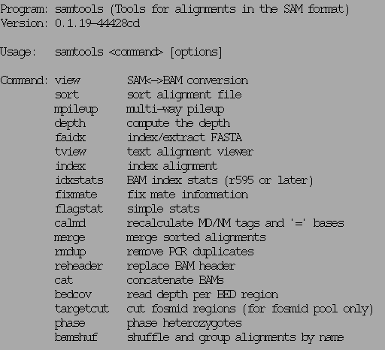
SAMTOOLS examples
http://www.htslib.org

Slide 42
SAMTOOLS view
Usage: samtools view [options] <in.bam>|<in.sam> [region1 [...]]
Options: -b output BAM
-h print header for the SAM output
-H print header only (no alignments)
-S input is SAM
-u uncompressed BAM output (force -b)
-1 fast compression (force -b)
-x output FLAG in HEX (samtools-C specific)
-X output FLAG in string (samtools-C specific)
-c print only the count of matching records
-B collapse the backward CIGAR operation
-@ INT number of BAM compression threads [0]
-L FILE output alignments overlapping the input BED FILE [null]
-t FILE list of reference names and lengths (force -S) [null]
-T FILE reference sequence file (force -S) [null]
-o FILE output file name [stdout]
-R FILE list of read groups to be outputted [null]
-f INT required flag, 0 for unset [0]
-F INT filtering flag, 0 for unset [0]
-q INT minimum mapping quality [0]
-l STR only output reads in library STR [null]
-r STR only output reads in read group STR [null]
-s FLOAT fraction of templates to subsample; integer part as seed [-1]
-? longer help
http://www.htslib.org

Slide 43
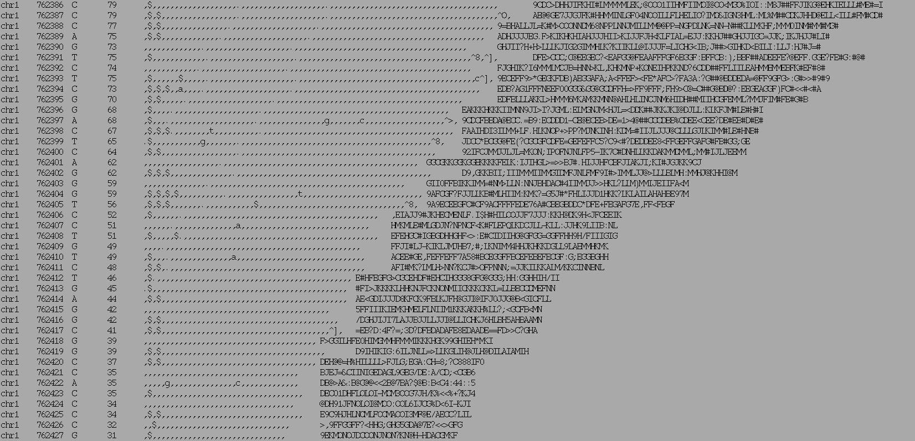
SAMTOOLS Pileup
Chrom
Ref
Read bases
Qualities
Position
Coverage

Slide 44
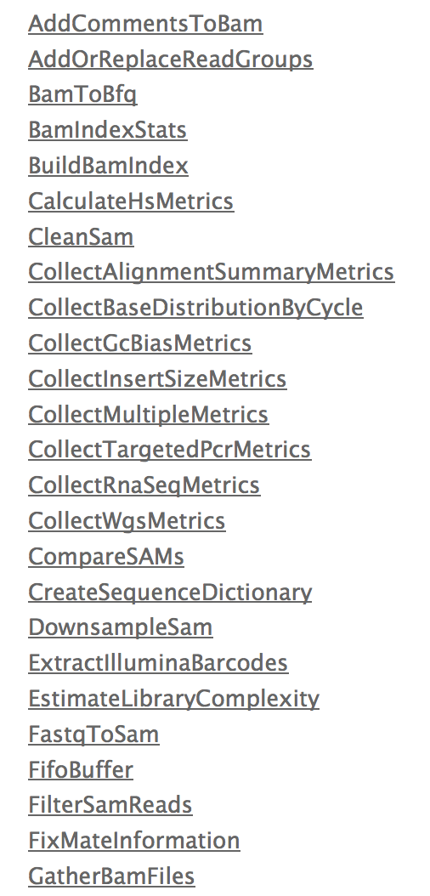
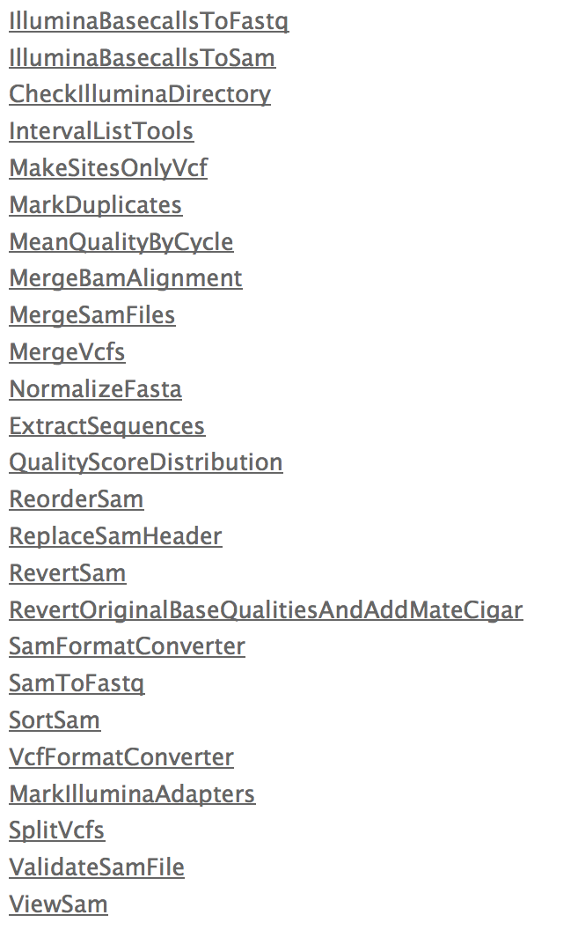
Picard – the other tool box
http://picard.sourceforge.net/

Slide 45
BED and BEDTOOLS
Interval Manipulation

Slide 46
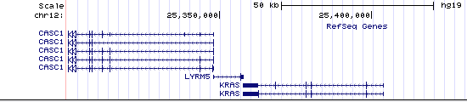
BED track

Slide 47
BED format
Header (space separated) [optional]
Chr [mandatory]
Start [mandatory]
Stop [mandatory]
Other (optional)
Name
Strand
Color
Type
A BAM alignment can be condensed into a BED file: Information loss !

Slide 48
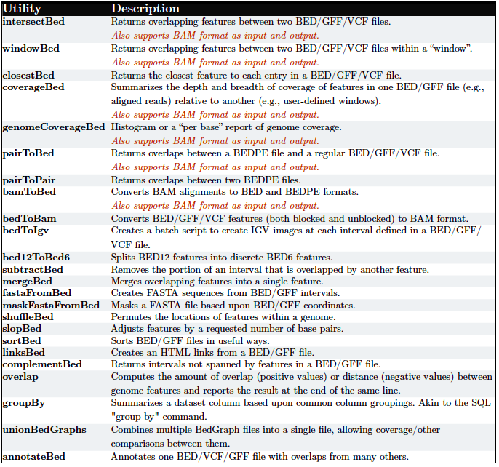
BEDTOOLS

Slide 49
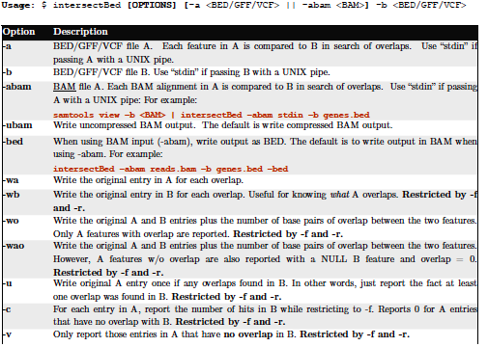
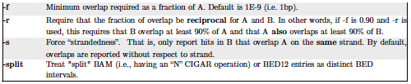
IntersectBed

Slide 50
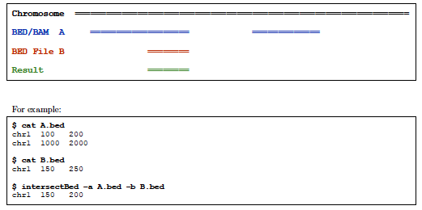
Intersect BED

Slide 51
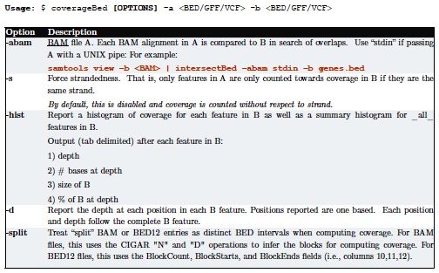
coverageBed

Slide 52
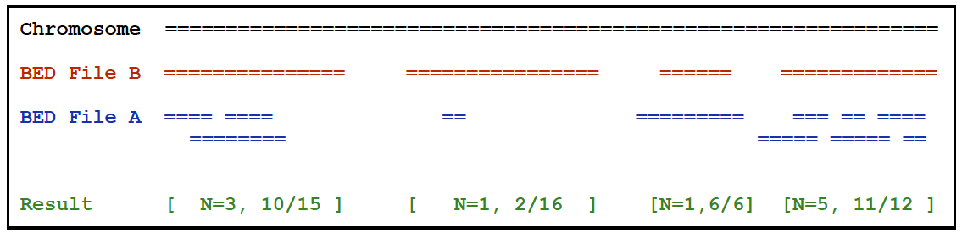
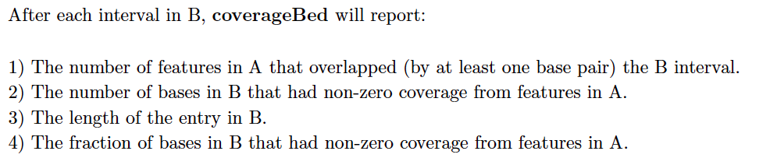
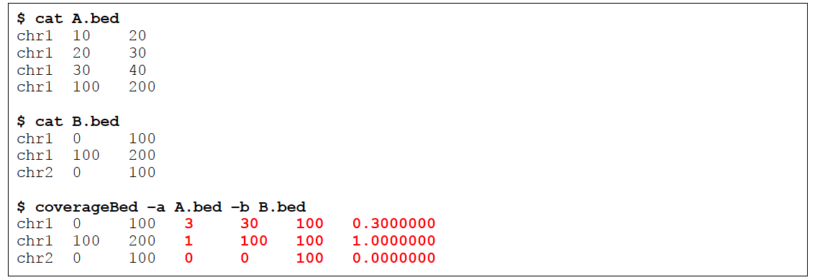
coverageBed

Slide 53
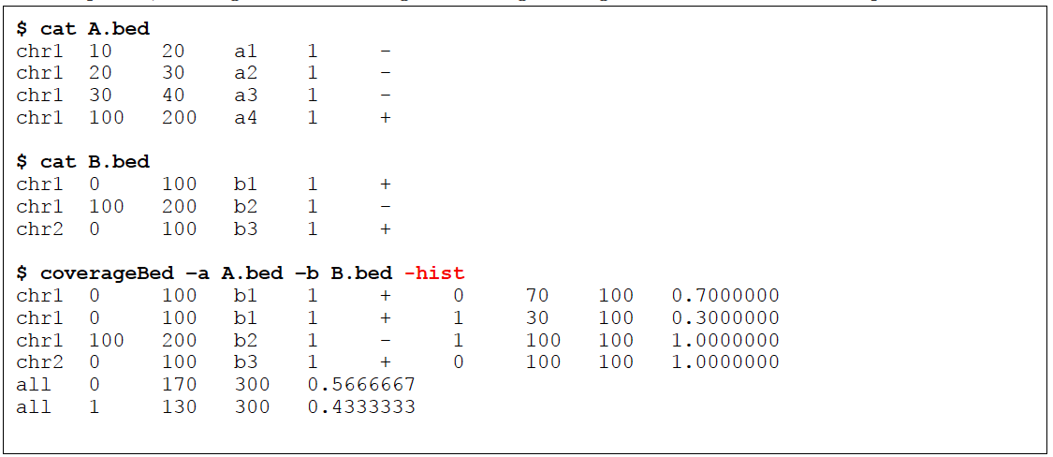
coverageBed

Slide 54
GATK
BAM postprocessing

Slide 55
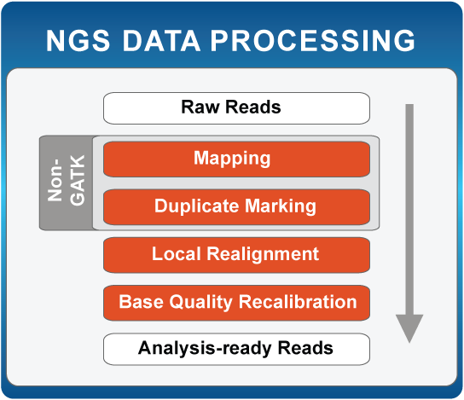
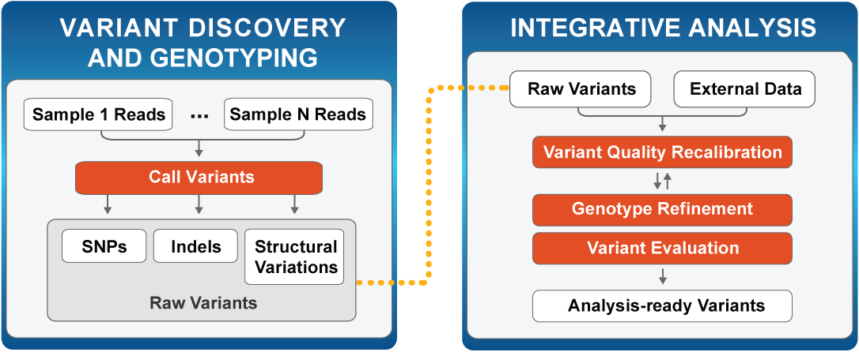
GATK workflows

Slide 56


MAPReduce
Each walker uses MAPreduce: high power
MultiThreading within GATK
-nc or –nct options
MapReduce or Scatter/Gather
Manage by “Queue”

Slide 57

GATK Best Practice

Slide 58


Slide 59


Slide 60


Slide 61


Slide 62


Slide 63


Slide 64

INDEL Realignment
The problem

Slide 65

INDEL Realignment
The problem

Slide 66

INDEL Realignment
The solution

Slide 67



Base Quality Recalibration
DePristo et al (2011)

Slide 68
ALIGNMENT VISUALISATION

Slide 69

SAMTOOLS tview
Samtools: TVIEW

Slide 70

Integrative Genome Viewer
http://www.broadinstitute.org/software/igv/

Slide 71
Integrative Genome Viewer
http://www.broadinstitute.org/software/igv/

Slide 72
Variant Calling
GATK/VARSCAN

Slide 73
Variant Calling
Bayesian Statistic
P(genotype|data)  P(data|genotype).P(genotype)
P(genotype) : prior probability for variant
P(data|genotype): likelihood for observed(called) allele
Likelihood P(data|genotype): What’s known to affect base calling:
• Error rate increases as cycle numbers increase
• Error rate depends on substitution type
• Error rate depends on local sequence

Slide 74


Slide 75


Slide 76

Bayesian

Slide 77

GATK Callers

Slide 78

Somatic Variant Calling
Compare Normal and Tumor directly
Results
Germline: Present in both
Somatic: Present in Tumor only
Loss of Heterozygosity: Missed Het in the tumor
Fisher Exact test
Kobolt et al. (2012)

Slide 79

Heuristic Filters

Slide 80
Variant ANALYSIS
VCF / VCFTOOLS

Slide 81

VCF format

Slide 82

VCF format

Slide 83

VCFTools
Indexed and Compressed
Perl Modules
merge
Concatenate
Export
Filtering
http://vcftools.sourceforge.net/perl_module.html

Slide 84
vcftools
VCF tools ~ PLINK
Output allele frequency for all sites in the input vcf file from chromosome 1
vcftools --gzvcf input_file.vcf.gz --freq --chr 1 --out chr1_analysis
Output a new vcf file from the input vcf file that removes any indel sites
vcftools --vcf input_file.vcf --remove-indels --recode --recode-INFO-all --out SNPs_only
Output files comparing and summarizing the individuals and sites in two vcf files
vcftools --gzvcf input_file1.vcf.gz --gzdiff input_file2.vcf.gz --out in1_v_in2
Output a new vcf file to standard out without any sites that have a filter tag, then compress it with gzip
vcftools --gzvcf input_file.vcf.gz --remove-filtered-all --recode --stdout | gzip -c > output_PASS_only.vcf.gz
Output a Hardy-Weinberg p-value for every site in the bcf file that does not have any missing genotypes
vcftools --bcf input_file.bcf --hardy --max-missing 1.0 --out output_noMissing
Output nucleotide diversity at a list of positions
zcat input_file.vcf.gz | vcftools --vcf - --site-pi --positions SNP_list.txt --out nucleotide_diversity
http://pngu.mgh.harvard.edu/~purcell/plink/
http://vcftools.sourceforge.net/man_latest.html

Slide 85
Variant ANNOTATION

Slide 86
Variant Annotation Tools
SNPEff (Broad)
http://snpeff.sourceforge.net
VEP (Sanger)
http://www.ensembl.org/info/docs/tools/vep/index.html
ANNOVAR
http://www.openbioinformatics.org/annovar/
Variant Tools (database / Manipulation
http://varianttools.sourceforge.net
McCarty et al: http://genomemedicine.com/content/6/3/26

Slide 87
SNPEff
Effects
SPLICE_SITE_ACCEPTOR SPLICE_SITE_DONOR START_LOST EXON_DELETED FRAME_SHIFT STOP_GAINED STOP_LOST RARE_AMINO_ACID
NON_SYNONYMOUS_CODING CODON_CHANGE CODON_INSERTION CODON_CHANGE_PLUS_CODON_INSERTION CODON_DELETION CODON_CHANGE_PLUS_CODON_DELETION UTR_5_DELETED UTR_3_DELETED
SYNONYMOUS_START NON_SYNONYMOUS_START START_GAINED SYNONYMOUS_CODING SYNONYMOUS_STOP NON_SYNONYMOUS_STOP
UTR_5_PRIME UTR_3_PRIME REGULATION UPSTREAM DOWNSTREAM GENE TRANSCRIPT EXON INTRON_CONSERVED INTRON INTRAGENIC INTERGENIC INTERGENIC_CONSERVED NONE CHROMOSOME CUSTOM CDS

Slide 88


ANNOVAR
exonic_variant_functoin

Slide 89

McCarty et al: http://genomemedicine.com/content/6/3/26

Slide 90

Annotation Challenges
Compensating mutations
DNP or TNP need to be annotated together
Phase of Indels on the same haplotype
Partial effects
Mutation affecting one transcript only
Same gene
Unknown Loss of Function mutations affecting known cancer genes
Adapted from MacArthur et al, 2012

Slide 91
Useful Annotations
dbSNP
dbNSFP
SIFT
MutationTaster
COSMIC
ESP data
1000G data
ExAC

Slide 92

Variant Effect Prediction
SIFT
Ng et al

Slide 93
Summary and Resources
Formats
FASTQ
SAM/BAM (CRAM)
VCF
Alignment and tools
BWA
IGV
Samtools
Post-Alignment Processing and QC
GATK IndelRealigner
GATK BaseRecalibrator
Picard MarkDuplicate
Picard HS-Metrics
Samtools
Variant Calling
GATK UnifiedGenotyper
GATK HaplotypeCaller
FreeBayes
VarScan (somatic)
Mutect (somatic)
Variant Annotations
SNPEff
ANNOVAR
Vtools
VEP

Slide 94
Other Resources/Tools
BaseSpace: the illumina app store
https://basespace.illumina.com
cBioportal: A repository of cancer genomics data
http://www.cbioportal.org
UCSC Cancer Genomic: A repository/browser of cancer genomics data
https://genome-cancer.ucsc.edu
MAGI: A tool for Mutation Annotation and Genomic Interpretation
http://magi.cs.brown.edu

